Slide 1

IT TICKET ANALYSIS
FEBIN GEORGE

Slide 2

Problem Statement
The objective is to analyze the IT support ticket management system to understand the performance of IT agents, the efficiency of ticket resolution, and the satisfaction levels of employees. The analysis aims to identify high and low performers among IT agents, assess the overall effectiveness of the team, and pinpoint areas for improvement in the ticket resolution process. The ultimate goal is to make informed staffing decisions, including hiring, firing, and training, to enhance overall service quality and team performance.

Slide 3
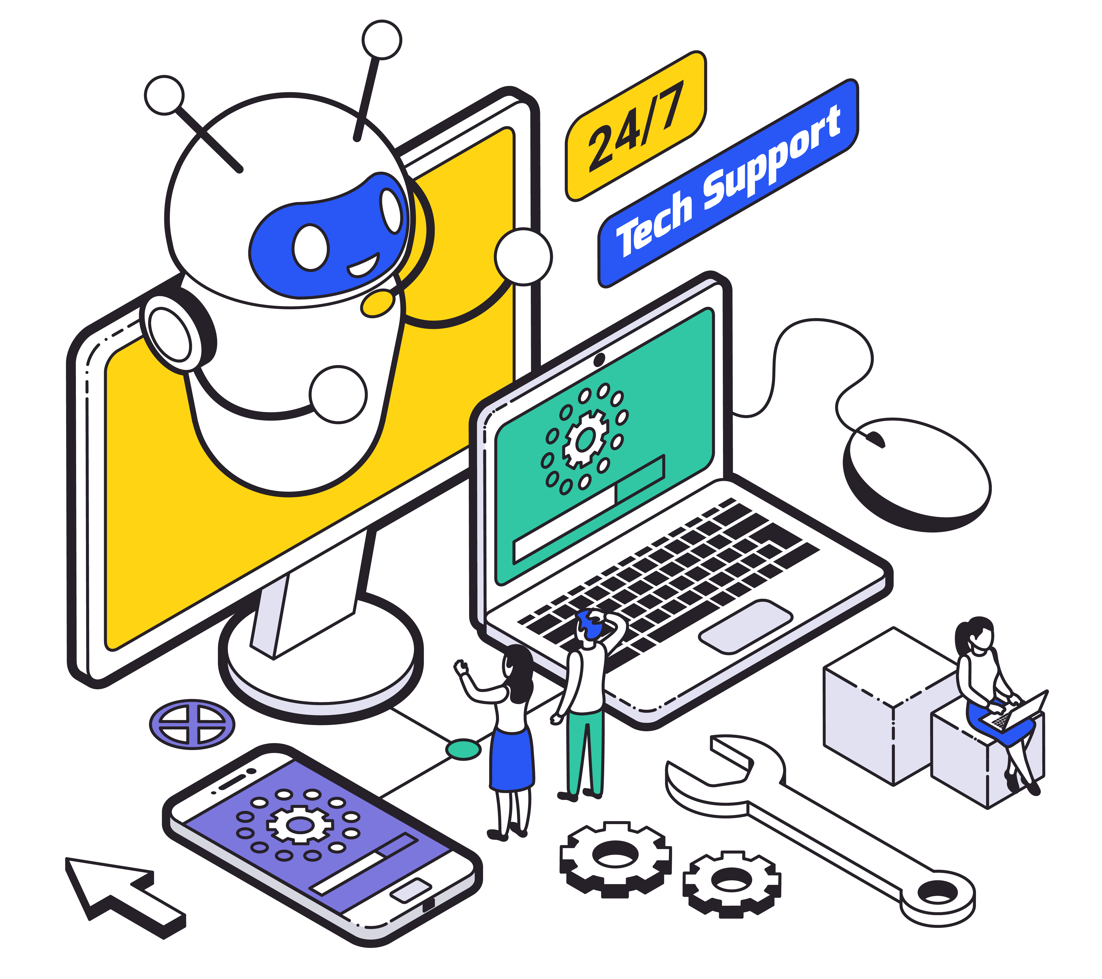
What is IT Ticket Management
IT Ticket Management is the systematic process of handling all incoming IT-related issues and service requests within an organization. It involves capturing, categorizing, prioritizing, assigning, tracking, and ultimately resolving these requests from their initiation to their closure. The core aim of this management system, typically facilitated by specialized help desk or service desk software, is to streamline IT support operations, ensure timely and effective problem resolution, and ultimately enhance the satisfaction of end-users by providing organized and efficient assistance.

Slide 4
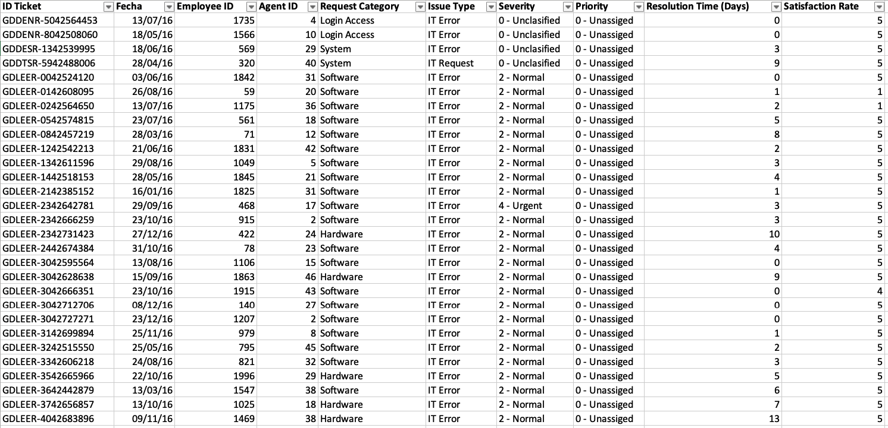
Tickets Sheet Data

Slide 5
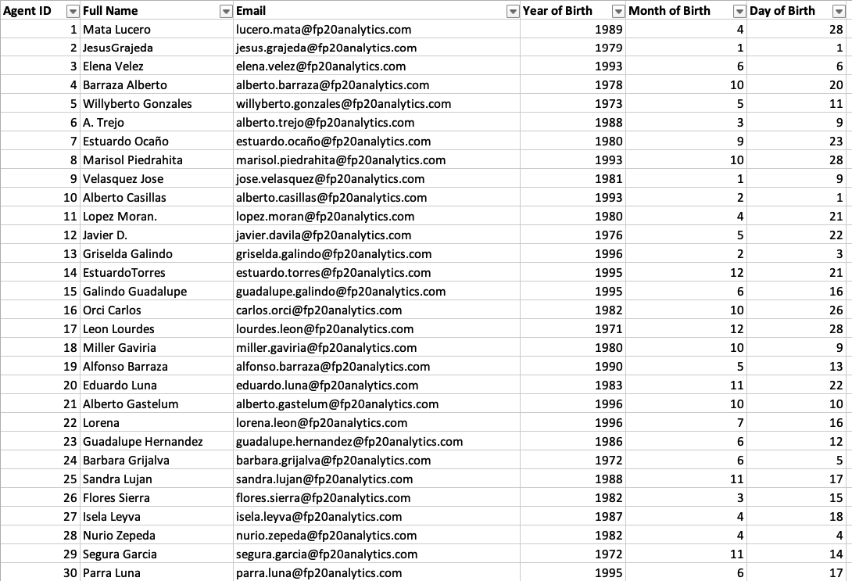
IT Agents Sheet Data

Slide 6
Data Attributes
IT Agents: Contains information about IT agents.
Agent ID: Unique identifier for the agent.
Full Name: Full name of the agent.
Email: Email address of the agent.
Year of Birth: Year the agent was born.
Month of Birth: Month the agent was born.
Day of Birth: Day the agent was born.
Tickets Sheet: Contains information about IT support tickets.
ID Ticket: Unique identifier for the ticket.
Fecha: Date of the ticket.
Employee ID: ID of the employee who raised the ticket.
Agent ID: ID of the agent assigned to the ticket.
Request Category: Category of the request (e.g., Login Access, System, Software).
Issue Type: Type of issue (e.g., IT Error, IT Request).
Severity: Severity of the issue.
Priority: Priority level of the issue.
Resolution Time (Days): Time taken to resolve the ticket.
Satisfaction Rate: Satisfaction rate provided by the employee (1-5 scale).

Slide 7
Data Overview
97,498 tickets in 5 years.
Number of Request Categories: 4
Unique Categories: Login Access, System, Software, Hardware
Number of Priorities: 4
Unique Priorities: Unassigned, High, Mid, Low.
Number of Agents: 50 agents
Number of Severities: 5
Unique Severities: Unclassified, Normal, Urgent, Major, Minor.
Data Cleaning and Preprocessing:
Fixed spelling mistakes in Priority and Severity.
Extracted the category from Priority and Severity.
Added agent details with tickets
Create a feature to group agents based on there Age.
Extracted the age of each agent.
Extracted domain name from agent email address.

Slide 8

Data Analytical approach and tools
Data Cleaning: Utilized functions TRIM,CLEAN,LEN,FIND,LEFT,RIGHT,ROUND.
Data Enrichment: Enhanced data set with additional variables using VLOOKUP to cross- reference external data source.
Trend analysis: Conducted time series analysis using PIVOT TABLE and Charts to find trend in tickets and its behavior.
Utilized DATE,DATEDIF to create feature columns in dataset.
Visualization: Created dynamic charts and dashboard for data representation, enabling interactive data exploration.
Filtering : Utilized Pivot table and Slicers feature to visualize and chronological filtering of data.
Conducted Cost Benefit Analysis for investment decision making.
Trend Analysis: Conducted time series analysis using line Chart.

Slide 9
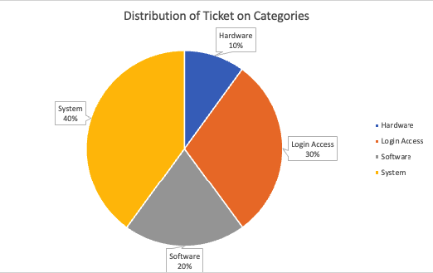
Insights
The average daily ticket volume is 53.
System and Login Access categories account for the vast majority of IT requests.
Hardware has the lowest ticket volume, but the longest resolution time.
System issues account for 40% of tickets, Login Access 30%, Software 20%, and Hardware 10%

Slide 10
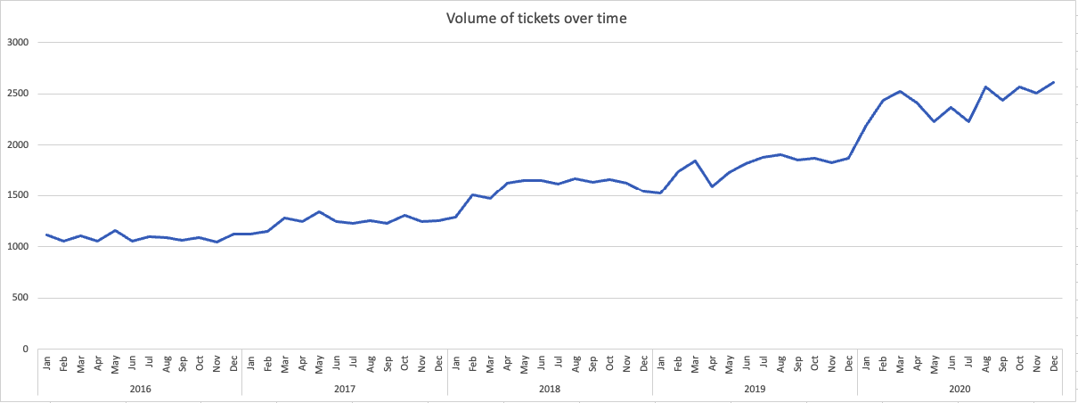
Insights
Ticket volume has shown consistent and significant growth from 2016 to 2020, more than doubling. 2020 saw the most dramatic acceleration, with monthly tickets exceeding 2,000 and reaching 2,609 in December.
Seasonal fluctuations exist with higher activity in Q1, mid-year, and year-end, but the overall trend is escalating demand.

Slide 11
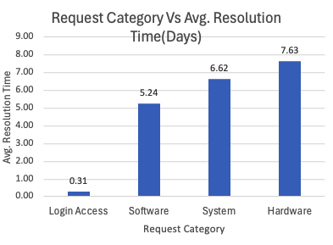
Insights
Hardware issues take the longest to resolve 7.63 days.
System issues average 6.62 days.
Software requests average 5.24 days.
Login Access requests are resolved very quickly (0.31 days).
Hardware resolution is a systemic issue affecting all agent age groups.

Slide 12
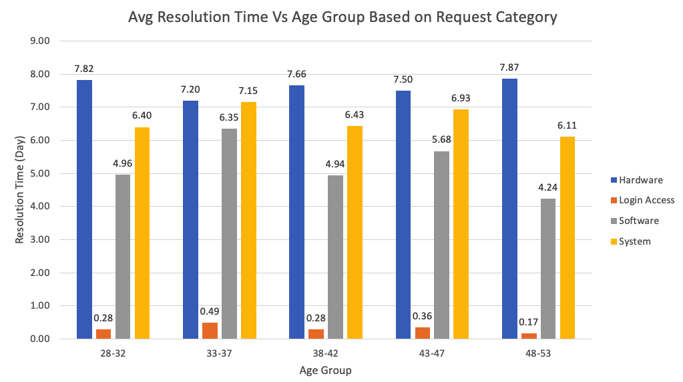
Insights
Hardware tickets have the longest resolution times for all agent age groups. This strongly indicates that the slowness is due to external factors or systemic process issues, not the specific agent's age or individual efficiency.
Login Access tickets are resolved quickly by all agent age groups, showcasing general IT efficiency in this area.

Slide 13
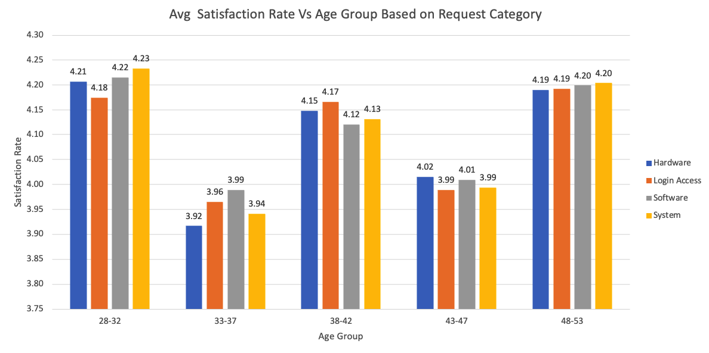
Insights
Customer satisfaction is consistently high around 4.00 to 4.20 for tickets handled by all IT agent age groups. This is a strong positive signal.
The 28-32 age group of agents achieves the highest average satisfaction rate 4.21.
The 33-37 and 43-47 age groups of agents show slightly lower overall satisfaction scores compared to others.
The 33-37 age group of agents, who have longer System and Software resolution times, also have a slightly lower satisfaction rate. This suggests that longer wait times, even if eventually resolved, can subtly impact satisfaction.

Slide 14
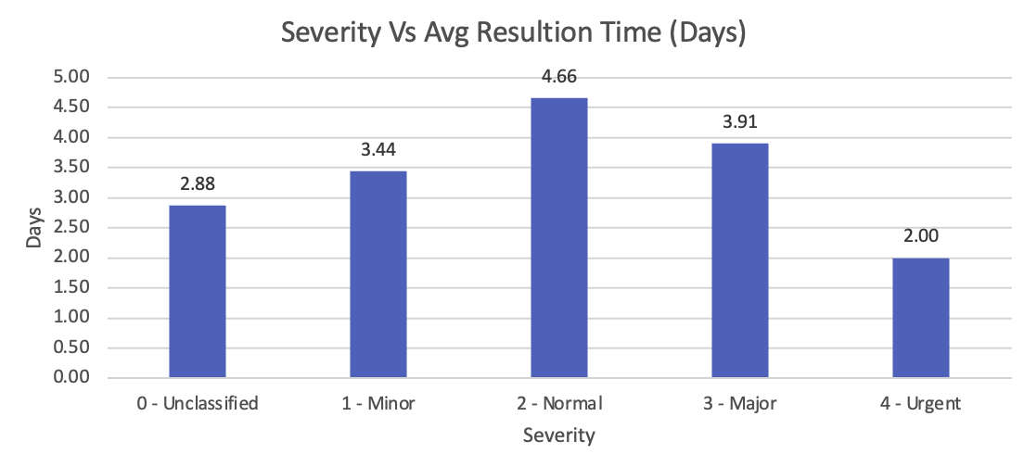
Insights
The system exhibits inefficiencies, such as Normal severity tickets taking longer to resolve 4.66 days than Major - 3.91 days or Urgent 2.00 days tickets, which is counter-intuitive.

Slide 15
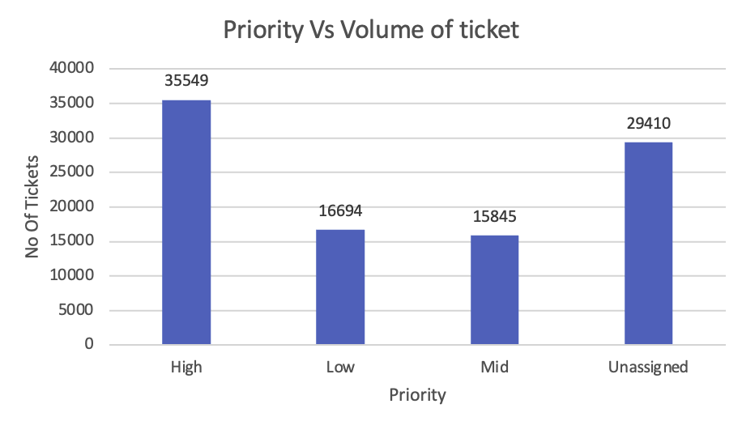
Insights
Over 30% of tickets (29,410 tickets) have an Unassigned priority, indicating a critical flaw in ticket management or usage.

Slide 16

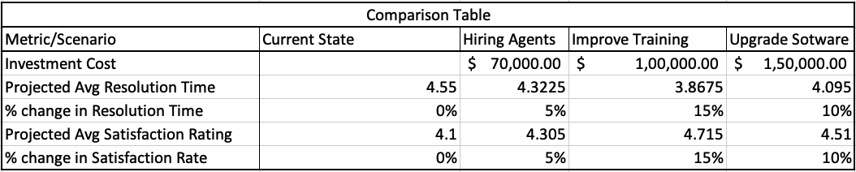
Recommendation
Investment Strategy based on Cost Benefit Analsysis
Short-to-Medium Term: Improve Training Programs. This offers high benefits in resolution time reduction and satisfaction improvement at a moderate financial cost, empowering the existing workforce.
Medium-to-Long Term: Upgrade Ticket Management Software. This is essential for sustainable growth, automation, and proactively reducing incoming demand, especially given the observed year-over-year ticket volume growth.

Slide 17
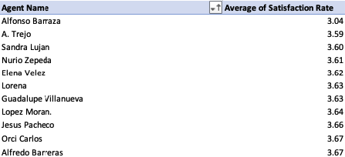
Recommendation
Targeted Agent Training:
For agents with low satisfaction ratings ,provide specialized training on customer service and communication skills.

Slide 18
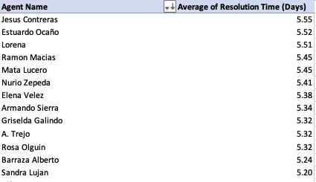
Recommendation
Targeted Agent Training:
or agents with long resolution times, implement technical proficiency and process efficiency training, focusing on advanced troubleshooting, diagnostic tools, and knowledge base utilization.
Specifically train the 33-37 age group on System and Software troubleshooting.

Slide 19
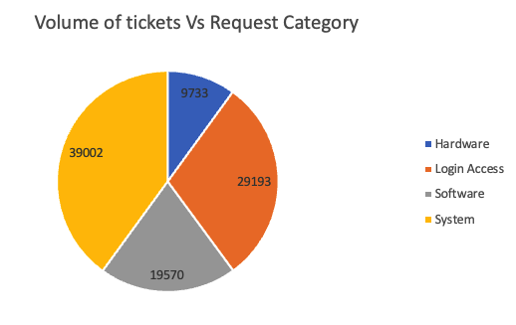
Recommendation
Optimizing Resolution Time by Category:
Analyze efficient processes for Login Access requests and adapt them to less complex issues in other categories.
Prioritize efforts on Hardware and System categories due to their long resolution times, including specialized technical training and enhancing knowledge bases for these complex issues.
Investigate System categories due to their high volume.

Slide 20

Recommendation
Improving Software Tool Effectiveness:
Reconfigure prioritization logic in the ticket management software and mandate priority assignment at ticket creation.
Conduct deep dives into workflows for Hardware, System, and Software tickets to identify bottlenecks within the software's current processes.
Invest in advanced self-service portals, automation (AI chatbots, intelligent routing), and enhanced knowledge bases to prevent tickets from reaching agents.

Slide 21
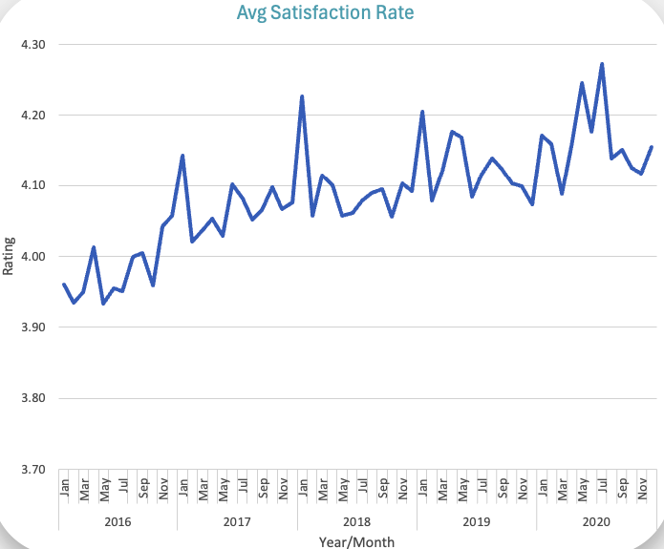
Recommendation
Managing Performance Trends:
Conduct a deep dive to identify factors contributing to the increasing average resolution time.
Leverage insights from high customer satisfaction to preserve and enhance aspects driving it while streamlining for speed.
Forecast future demand and assess staffing and skill set adequacy based on increasing resolution times.

Slide 22
Recommendation
Strategic Tech Investments:
For high-volume categories like System and Login Access, focus on automation and self-service solutions (e.g., automated password resets, proactive monitoring, initial diagnostics).
For Hardware, invest in better IT Asset Management systems, efficient spare parts inventory, and enhanced service level agreements with vendors.
For System and Software, invest in advanced remote diagnostic tools and a robust, searchable knowledge management system.
Invest in IT Ticket Management software with better routing and workload balancing.

Slide 23
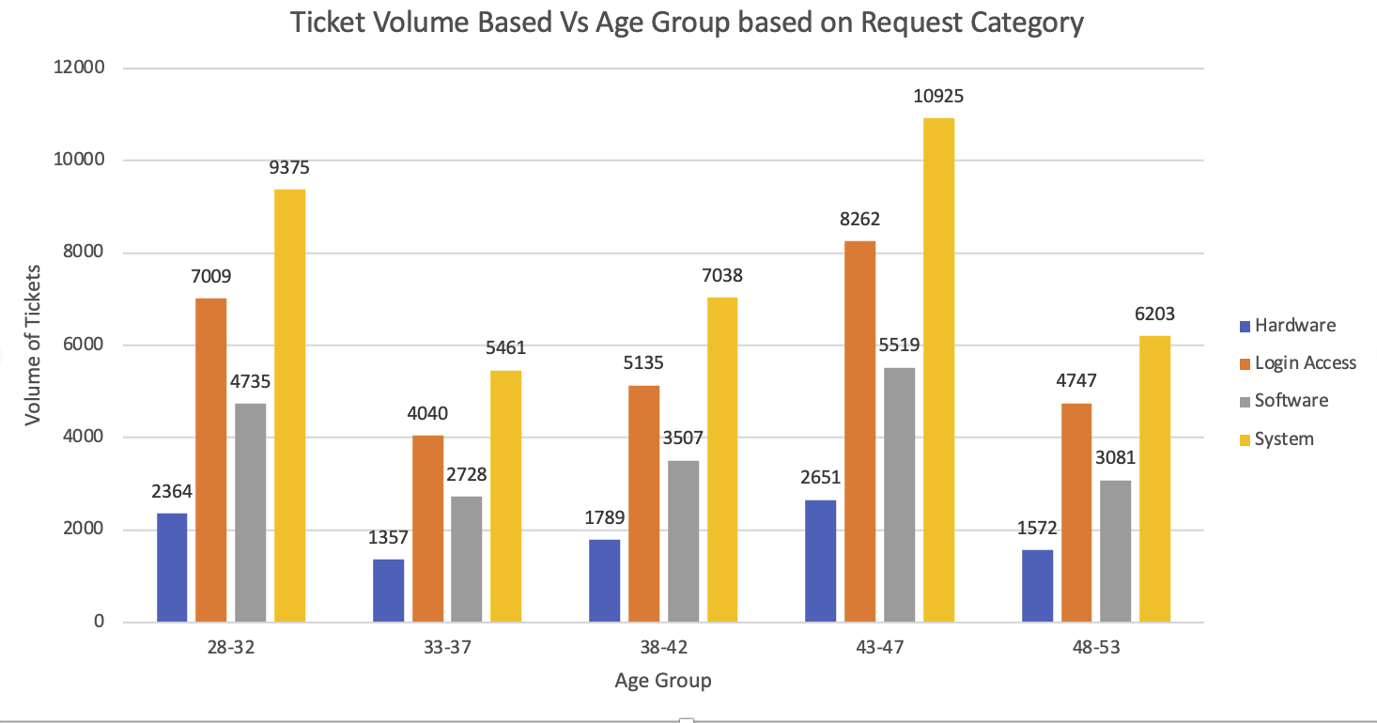
Recommendation
Leveraging Agent Expertise:
Encourage high-volume agents (28-32 and 43-47 age groups) to document solutions in the knowledge base.
Utilize the expertise of 48-53 age group agents for mentorship, knowledge base refinement, and handling complex/high-priority tickets.

Slide 24
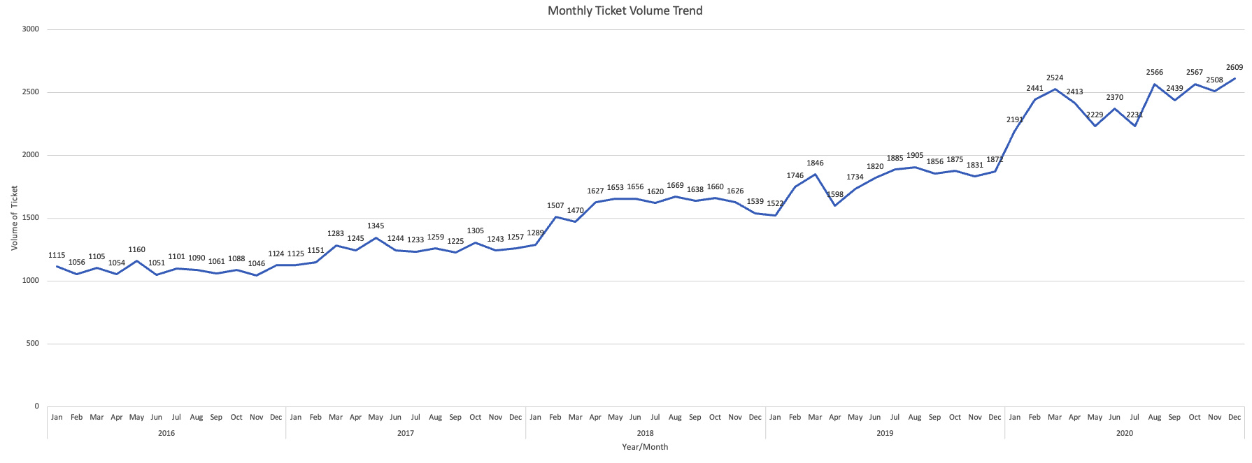
Recommendation
Plan for Re-occurring Trends:
Plan for increased IT staff and resources from June to September due to mid-year peaks.
Utilize lower volume months (April-May leading to peak, January-February, November-December off-peak) for proactive checks, system updates, staff training, and strategic planning.

Slide 25
Key Findings
Summary of Key Findings & Implications:
Ticket volume has more than doubled in five years, straining existing resources and causing resolution times to increase, particularly for complex Hardware and System issues.
Despite rising workloads and longer resolution times, customer satisfaction remains high. However, there are notable performance differences among agent age groups, with specific groups showing excellence in certain areas and underperformance in others.
The current ticket management software exhibits critical flaws, as evidenced by a large number of unassigned priorities and illogical resolution times (e.g., "Normal" tickets taking longer than "Major" ones).

Slide 26
Highly Suggested
Prioritize investing in enhanced ticket management software and agent training. These are the most impactful levers for scaling operations, improving efficiency, and managing the accelerating demand.
Implement targeted training for agents to address specific performance gaps and leverage the expertise of high-performing teams for mentorship and knowledge sharing.
Standardize ticket prioritization and streamline workflows, especially for Hardware and System requests, which are the most time-consuming to resolve.

Slide 27
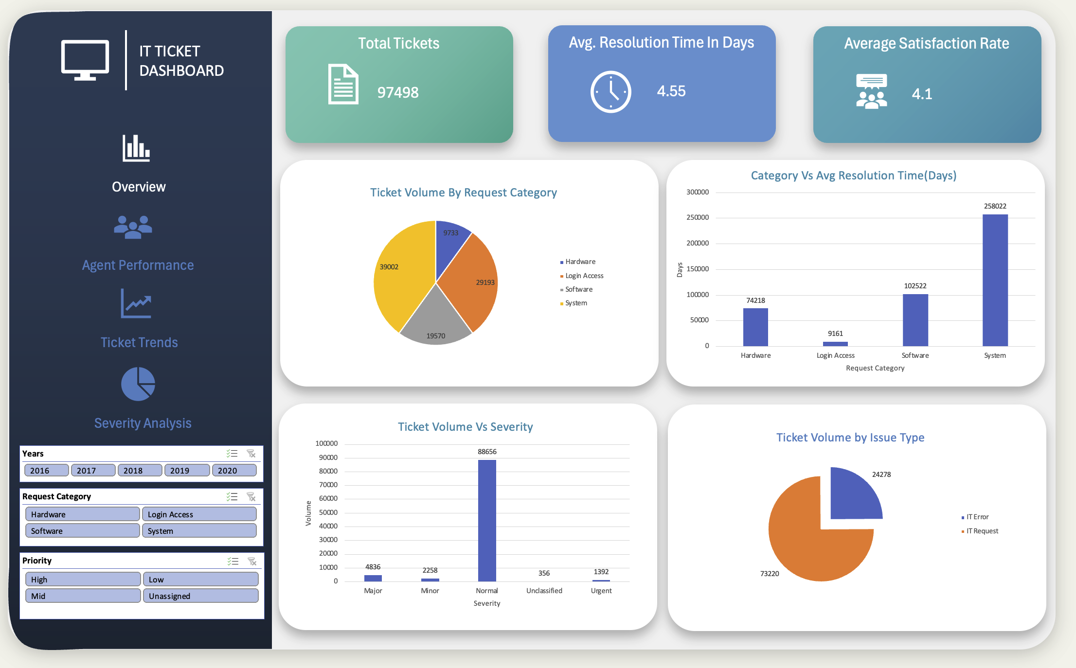
Dashboard

Slide 28
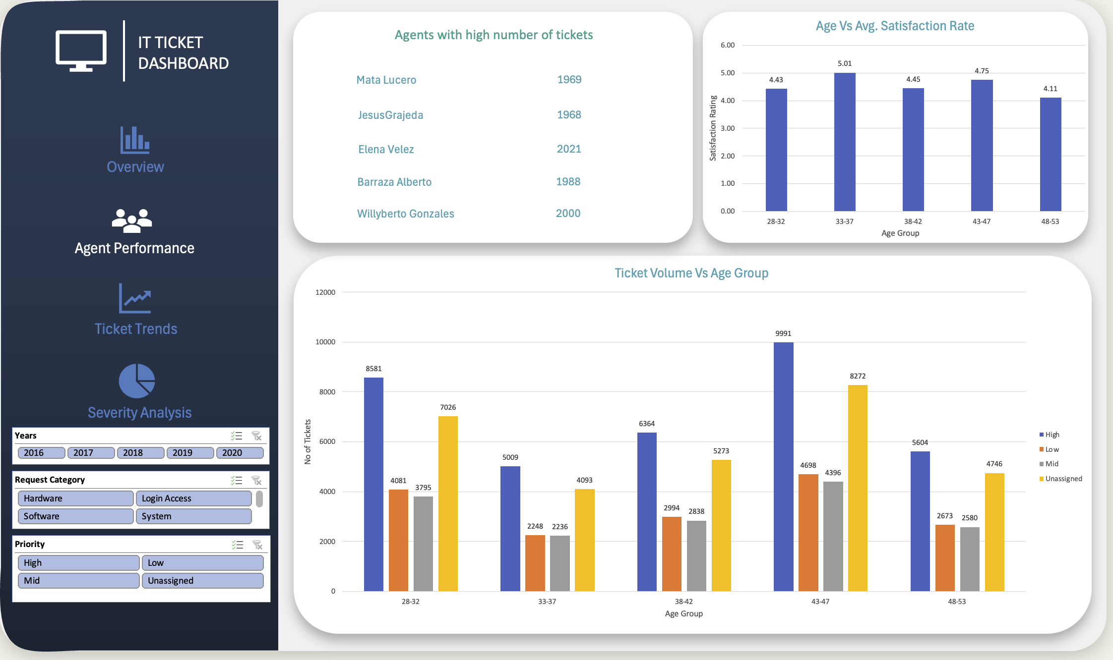

Slide 29
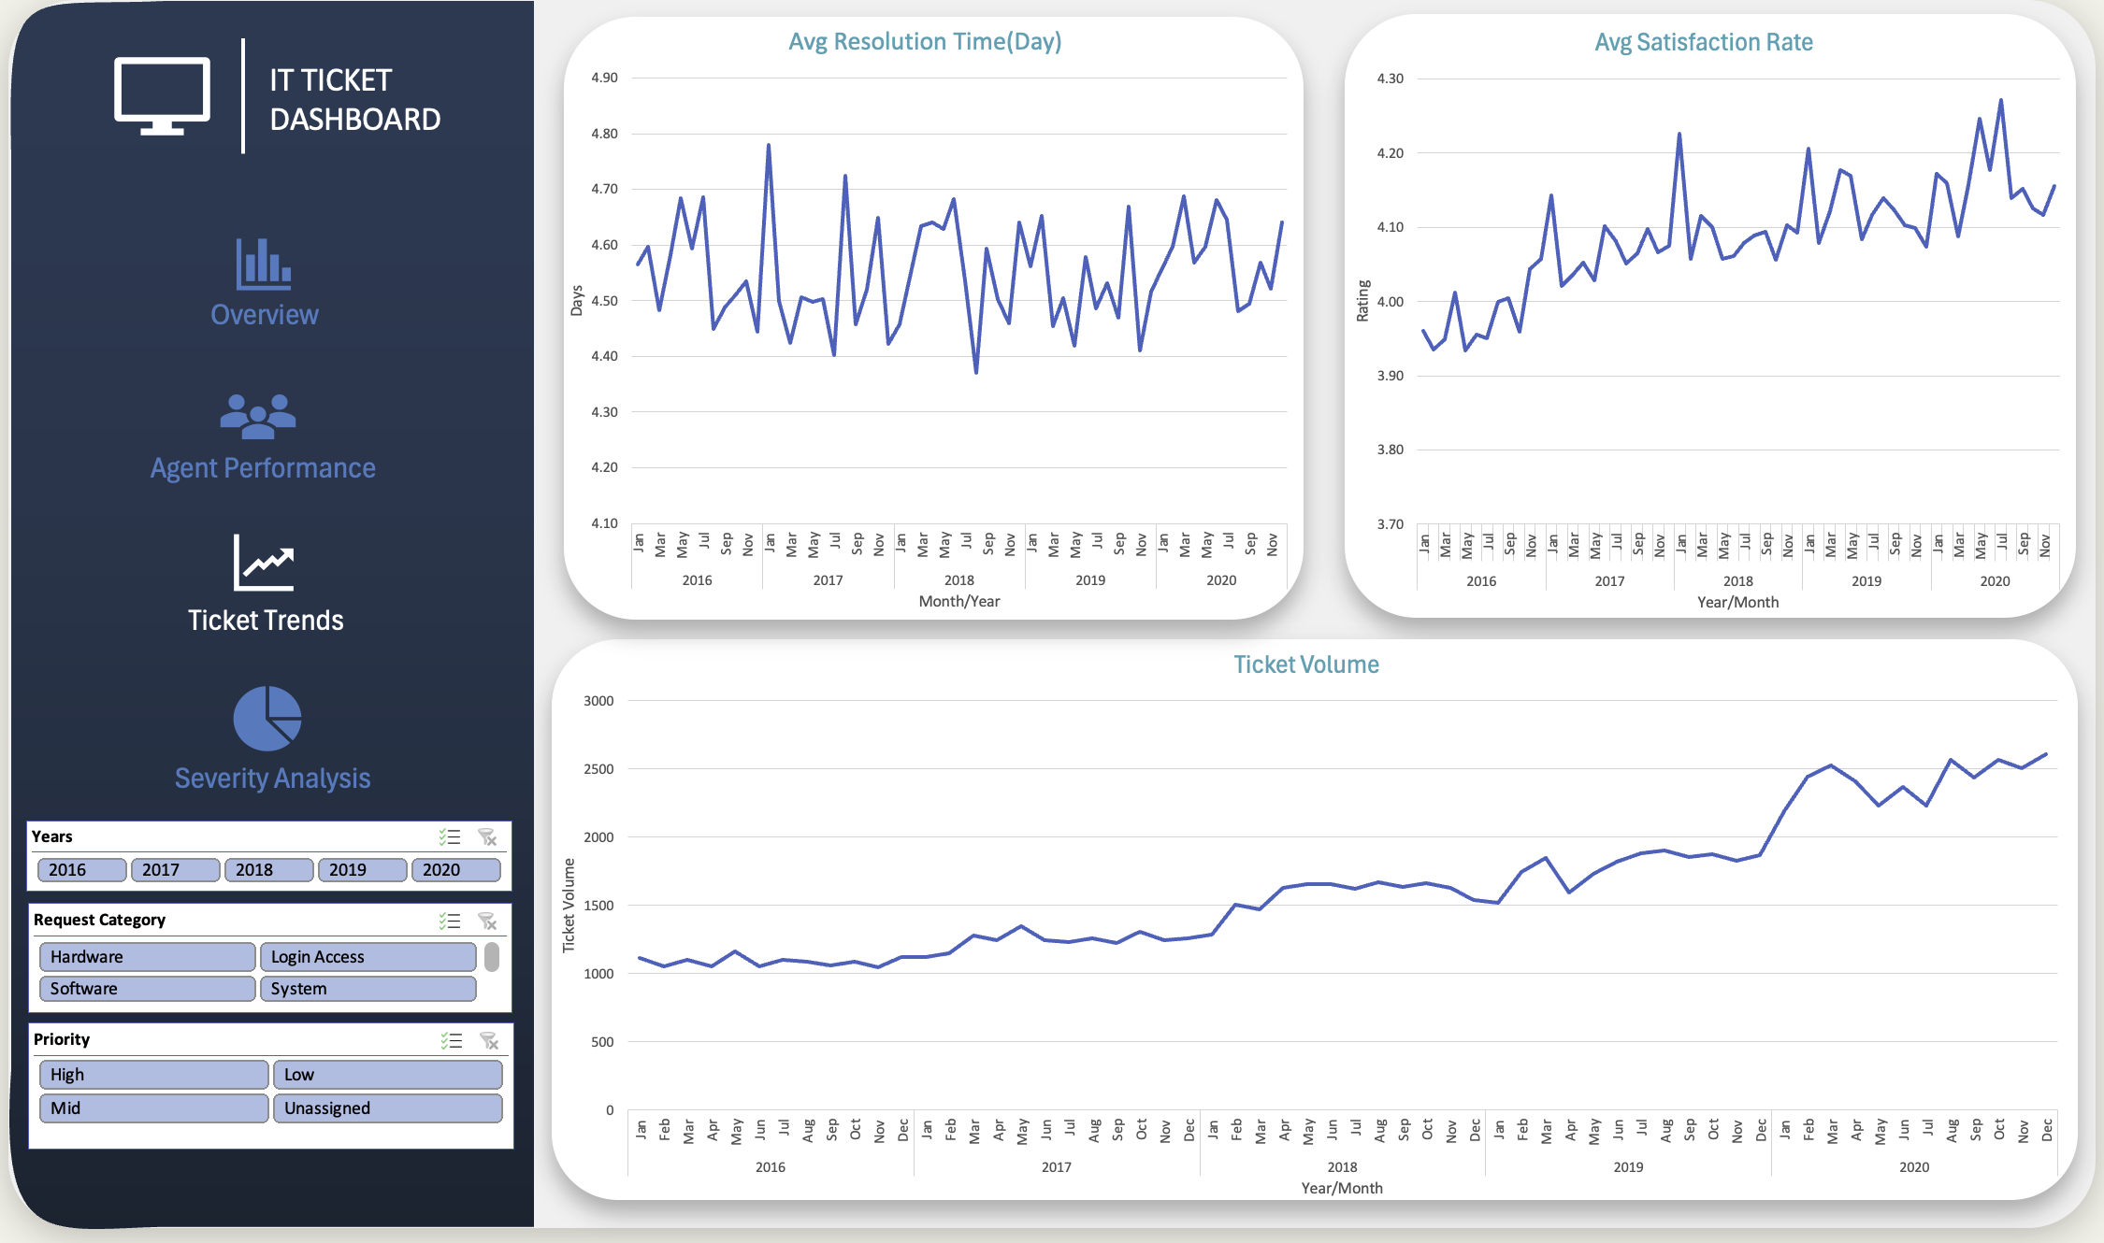

Slide 30
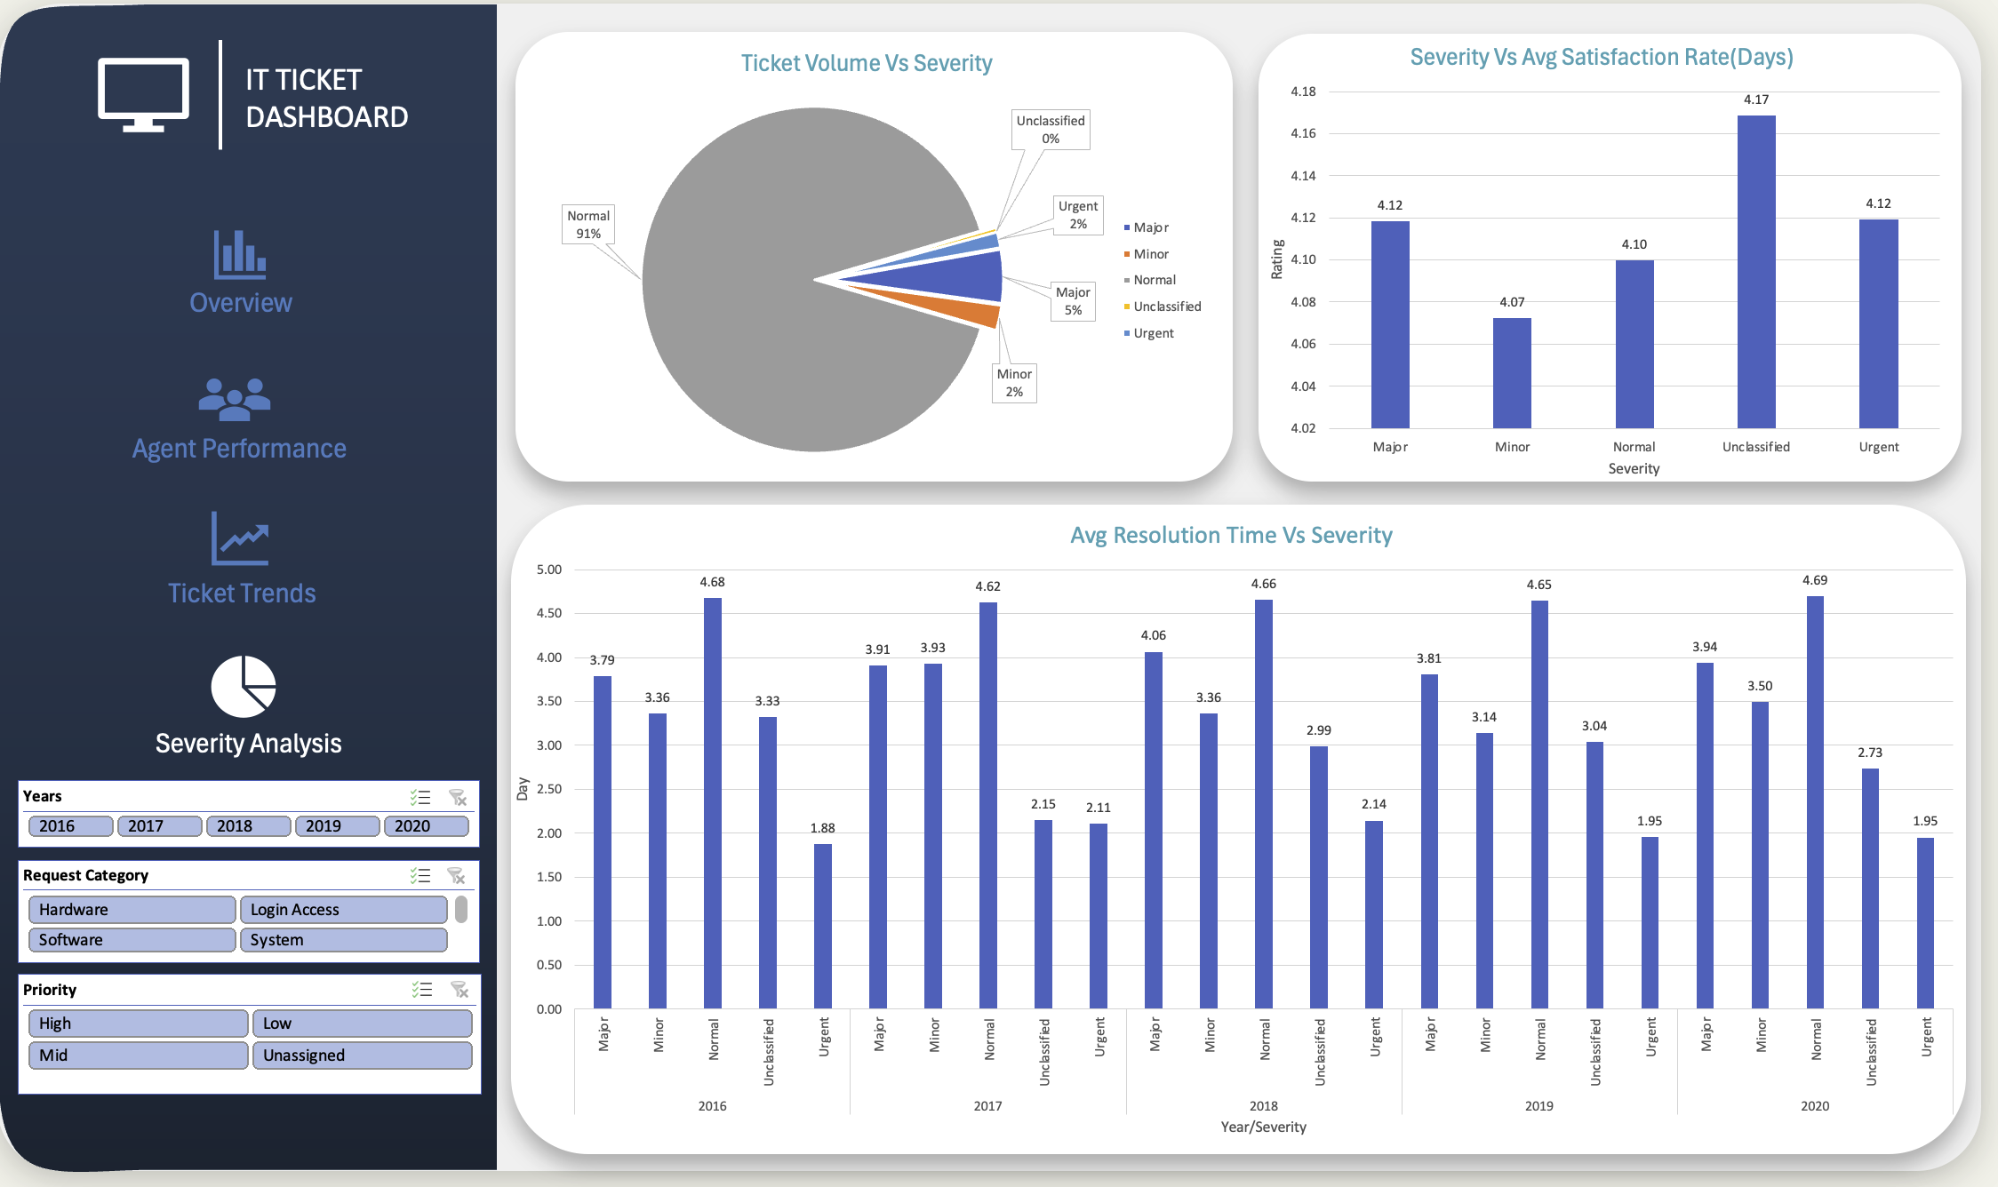

Slide 31
Conclusion
This analysis provides a clear roadmap to transform a growing but reactive IT support function into a proactive, efficient, and scalable operation. By strategically investing in our people and technology, we can sustain high customer satisfaction while successfully meeting the future demands of our organization.
The IT support team is facing a challenge of ever-increasing ticket volume, but has successfully maintained high customer satisfaction. The current system is inefficient, with issues like unassigned priorities. The most effective short-term solution is to invest in training to empower agents and reduce resolution times. For long-term sustainability, a strategic upgrade of the ticket management software is essential to proactively reduce demand and ensure a scalable operation.

